Slide 1
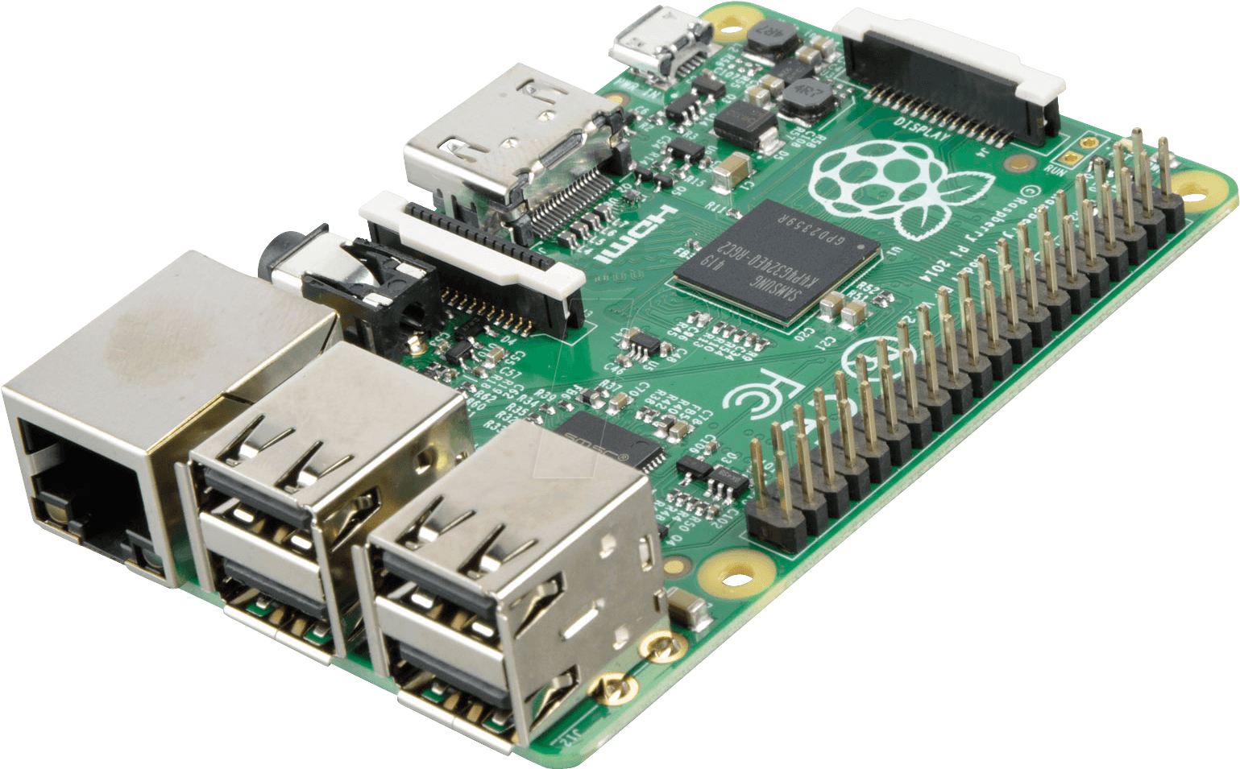

Pertemuan 7
Image Processing Part 3
Thresholding Otsu
Belajar
Image Processing di Raspberry Pi

Slide 2
Thresholding Otsu

Slide 3
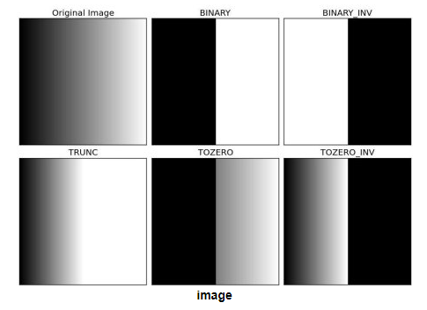
Thresholding
Image Binarization/Thresholding adalah proses membuat sebuah gambar menjadi hitam putih (image hanya memiliki nilai pixel 0 atau 255) dengan menerapkan batas threshold tertentu.
Menggunakan method cv2.threshold(img, threshold_value, max_value, threshold_type)
Untuk :
img : input image
threshold_value : The thresh value with respect to which the thresholding operation is made
max_value : The value used with the Binary thresholding operations (to set the chosen pixels)
threshold_type : One of the 5 thresholding operations.
cv2.THRESH_BINARY
cv2.THRESH_BINARY_INV
cv2.THRESH_TRUNC
cv2.THRESH_TOZERO
cv2.THRESH_TOZERO_INV

Slide 4
Threshold Binary on Image
Import library (OpenCV, Matplotlib)
Display Image
import cv2
import matplotlib.pyplot as plt
import os
def show_image_binary(binary, title= 'my image', size=(10, 7)):
plt.figure(figsize=size)
plt.imshow(binary, cmap='gray')
plt.title(title)
plt.axis('off')
show_image(binary, title= 'threshold binary image')
print('threshold value : %d' % ret)
Read Image
img = cv2.imread('path/to/filename')
Threshold
ret, binary= cv2.threshold(img, 230, 255, cv2.THRESH_BINARY)

Slide 5
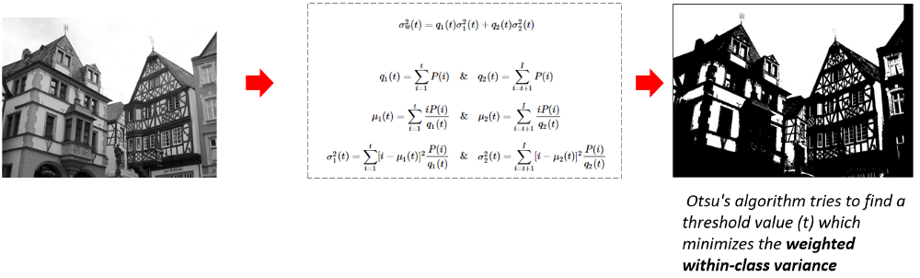
Thresholding Otsu
Metode otsu merupakan metode untuk menentukan titik ambang batas optimal untuk melakukan thresholding.
Hal ini dilakukan dengan meminimalkan variansi intrakelas,
Dan memaksimalkan variansi antarkelas dari kelas-kelas yang dipisahkan dengan threshold

Slide 6
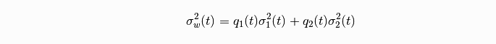
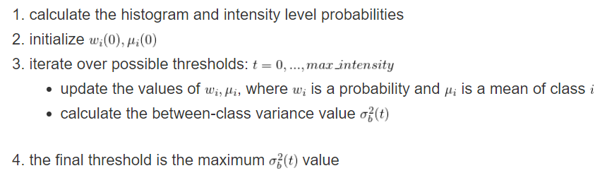
Thresholding Otsu

Slide 7
Threshold Otsu on Image
Read Image
img = cv2.imread('path/to/filename')
Threshold
ret, binary= cv2.threshold(img, 0, 255, cv2.THRESH_BINARY + cv2.THRESH_OTSU )
Display Image
show_image(binary, title= 'threshold otsu image')
print('threshold value : %d' % ret)
cv2.THRESH_OTSU merupakan flag untuk thresholding Otsu pada OpenCV

Slide 8
Threshold Otsu on Multiple Image
Threshold otsu multiple image menggunakan library os
filenames = os.listdir("folder_1")
for name in filenames :
print(name)
img = cv2.imread(name)
ret, binary= cv2.threshold(img, 0, 255, cv2.THRESH_BINARY + cv2.THRESH_OTSU )
show_image(binary, title= 'threshold otsu image: %s (value : %d)' % (name, ret))
print('threshold value : %d' % ret)

Slide 9
Sumber
https://github.com/Muhammad-Yunus/Belajar-Computer-Vision/blob/master/09.%20OpenCV%20-%20Part%203/OpenCV%20-%20Part%203.ipynb
https://www.learnopencv.com/otsu-thresholding-with-opencv/

